Slide 1

University of Illinois REU Introduction to Matlab
Compiled by Erik Huemiller

Slide 2
Goals for the Crash Course
Start With
Matlab loaded on a computer
No prior experience with Matlab
End with the ability to
Learn how to operate in the Matlab Environment
Create and Import data to visualize it in plots
Fit a model to the data and analyze the error

Slide 3
Resources if you get stuck
Matlab Documentation (online)
Easiest to find through a Google search of “Matlab + command”
There is example code with an explanation of most commands
Links to similar commands are listed at the bottom of the page
BYU Intro to Matlab
Loosely used as an outline for this crash course
PDF with less explicit cross references than the online material
Weitzman Institute
PDF and PPT lectures with slides and example code
Slow moving course designed for people that have never coded before.
Email grad student mentor with questions
Slower response, but can give individual feedback
Can meet up in person to work through a tough problem
Has experience fitting data similar to the data you are fitting in your field

Slide 4
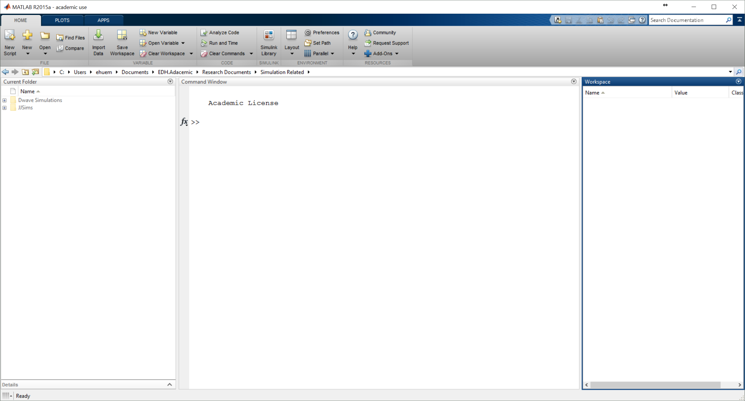
When you open Matlab
Tools for Running Program
Saving, Running, Changing Preferences
Current Folder
This is where you can find your programs
Command Window
This is where you enter Commands
It is also where the output is displayed
Workspace
This shows variables you have made

Slide 5
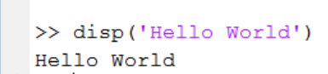
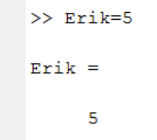
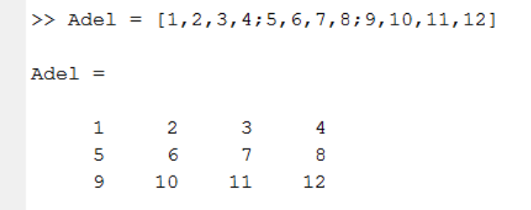
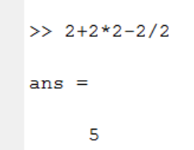
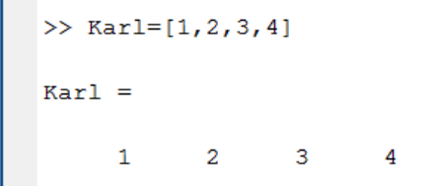
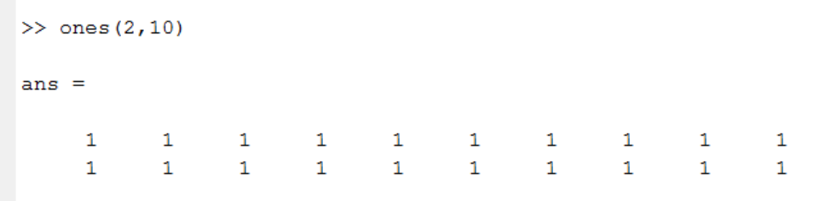
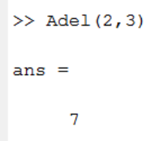
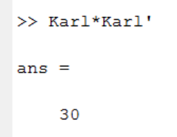
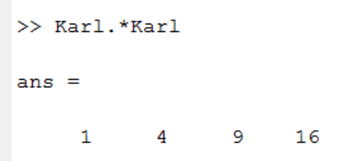
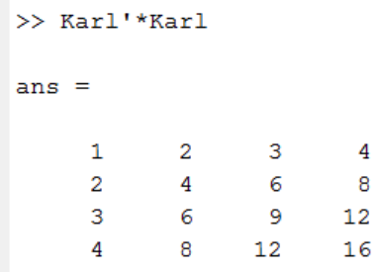

Playing with Variables in Matlab
Some things to try
Display a string of words
Using it as a calculator (+, -, *, /)
Create a variable (=)
Create a vector and a matrix
Taking the transpose of a matrix (‘)
Create a matrix of ones or zeros
Accessing an element of a matrix
Matrix multiplication (* vs .*)
What does adding a “;” at the end of a line do?
What do different clearing commands do (like clear, clc, clear all)?
What happens if you take the sin or cosine of a variable/vector/matrix?

Slide 6
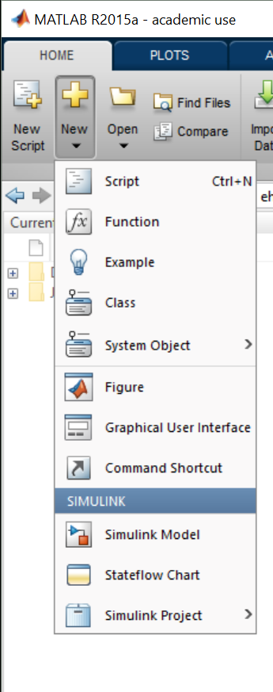
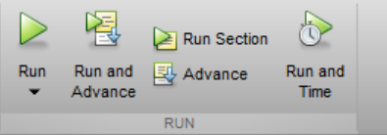
.m files and writing programs
Try to write a program that will create a variable but not output it yet, and print the phrase “Hello World” in the command window. Then the program should print the value of the variable squared.
When you have written it, save it in the home directory and hit the run button.
Some notes about file names
Stick with Alpha Numeric
No Spaces allowed (use underscore instead for spaces)
Some notes about Variable Names
Try to make them descriptive in the program
Keep them short so that its easier to type them without mistakes
No spaces allowed (use underscore instead for spaces)

Slide 7
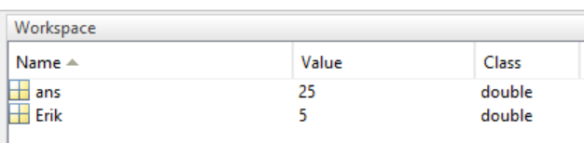
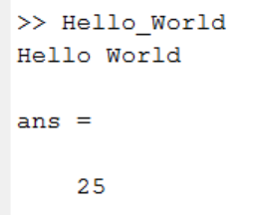
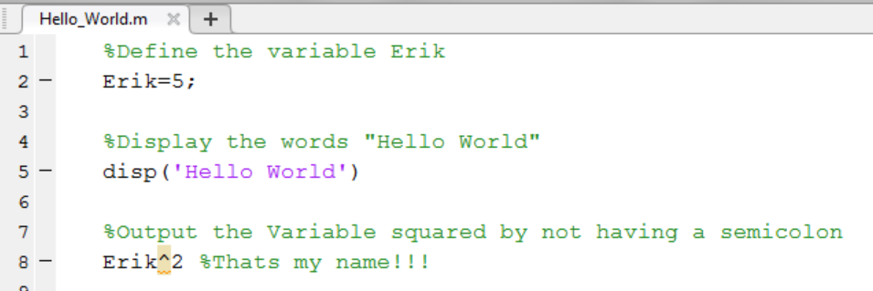
Here is what mine looks like
The output
There are also some variables in the workspace that are left over from the program.
When you do not specify an output variable, MATLAB uses the variable ans, short for answer, to store the results of your calculation.
The program
By Placing a “%” in a line it will prevent Matlab from running the rest of the line. This can be useful for leaving comments or explanations of what your program does in case someone else will want/need to use it in the future.

Slide 8
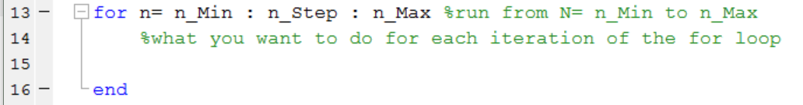
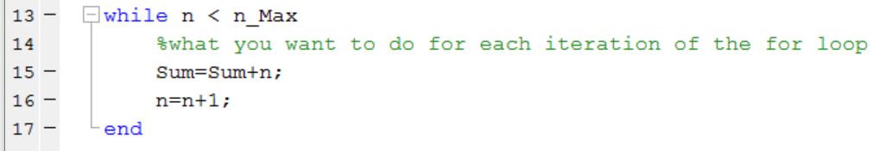
Writing Programs with Loops
For Loops
The loop runs for values in a range dictated by the input
While Loops
The Loop runs while an inequality is satisfied.
Be careful of factors of 1 in this kind of loop.
Try to write a program that sums the first 100 integers using a for loop. Can you make it only count the 10s between 0 and 100?

Slide 9
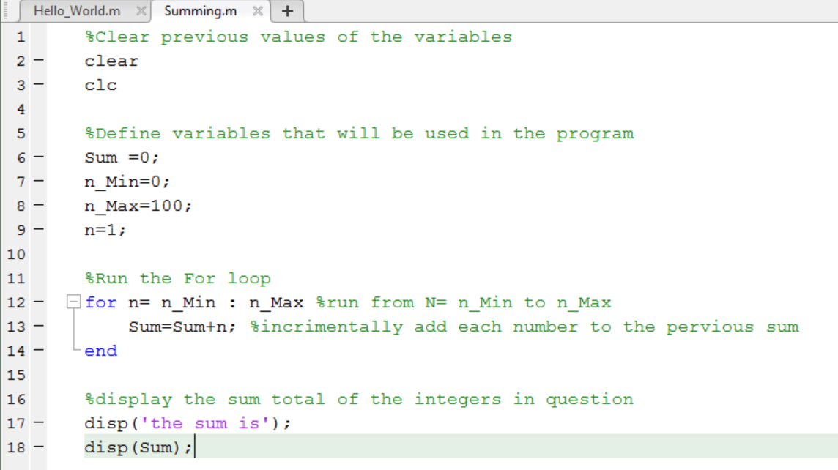

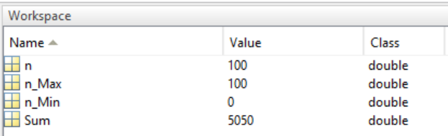
Here is what my for loop looks like
Output
.m file

Slide 10
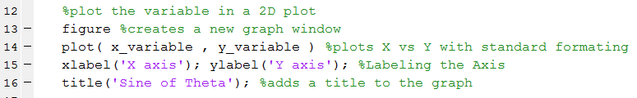
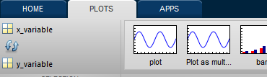

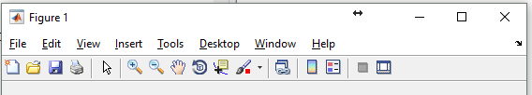
Plotting in 2D and 3D
In Code plotting
Create the figure
Plot the variables that are the same length
Add formatting after the second variable
Add labels and a title in the next line
Using the GUI to plot graphs
Select the variable you want to plot
Click on the type of plot you want to use
Open Plot Tools and Dock Figure
Adjust the range and setup using the toolbar
Try to write a program that plots a sine function on a 2D plot with 500 points in the plot with Title and axis labels. Then try and replicate the graph using the GUI.

Slide 11
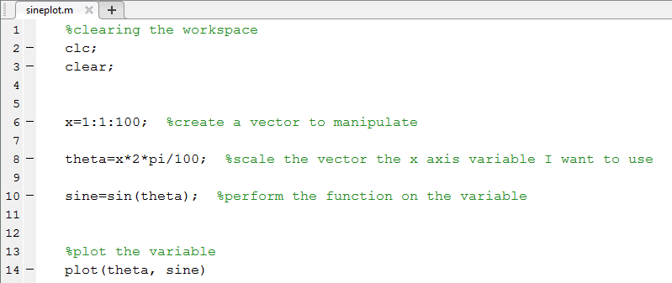
Here is what mine looks like

Slide 12
Some other graphing capabilities to try
Download the Boston Marathon results from github and make some other graphs
Some things to try
Histograms of race results
Multiple line 2D plot
3D plotting
Break down results by gender/age
Tomorrow’s session will focus more on fitting and data analysis

